Slide 1
Diabetes Prediction
Team Members:
Taylor Wilson
Lyvia Nguyen
Alan Grubb
Kikelomo Ijagbemi
Dev Paul

Slide 2



Project Description
In our project, we will utilize machine learning methodologies to make predictions regarding the likelihood for diabetes in patients. Their demographics and specific factors of their medical history will be analyzed. Our dataset has 100,000 data points with 9 variables. Our approach involves the utilization of the following key components:
Employing a sequential and random forest model.
Harnessing the capabilities of Tableau for visualizations.
Employing Pandas and Seaborn for data manipulation and visualizations.
Utilizing Scikit-Learn library for machine learning tasks.
8.5% of our dataset answered “yes” to having diabetes.

Slide 3
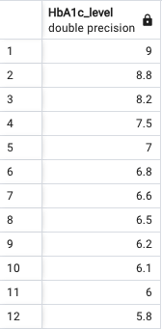
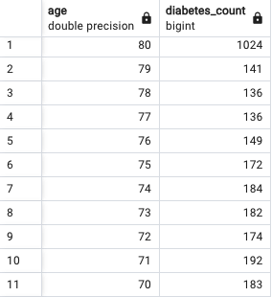
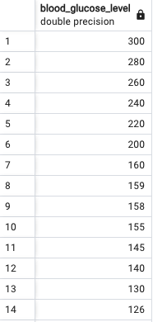
Data Management with SQL
Healthy HbA1c levels are below 5.7%.
Advanced age can be a determining factor for a person having diabetes.
Expected values for blood sugar with fasting is 70 to 100 mg/DL.

Slide 4
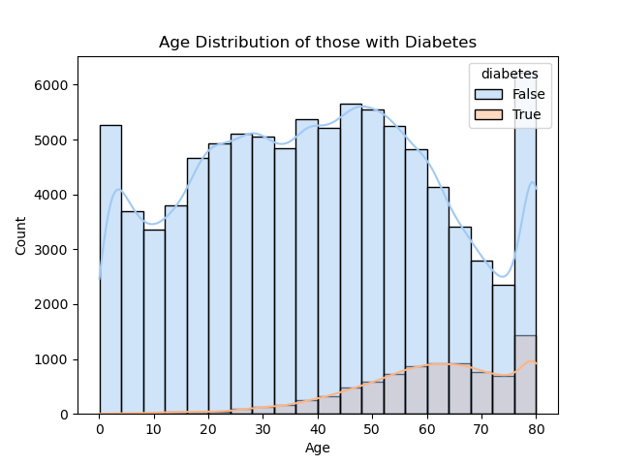
Age vs. Diabetes
Analyzing the age distribution of those with diabetes.
As one ages the likelihood of developing diabetes increases.

Slide 5
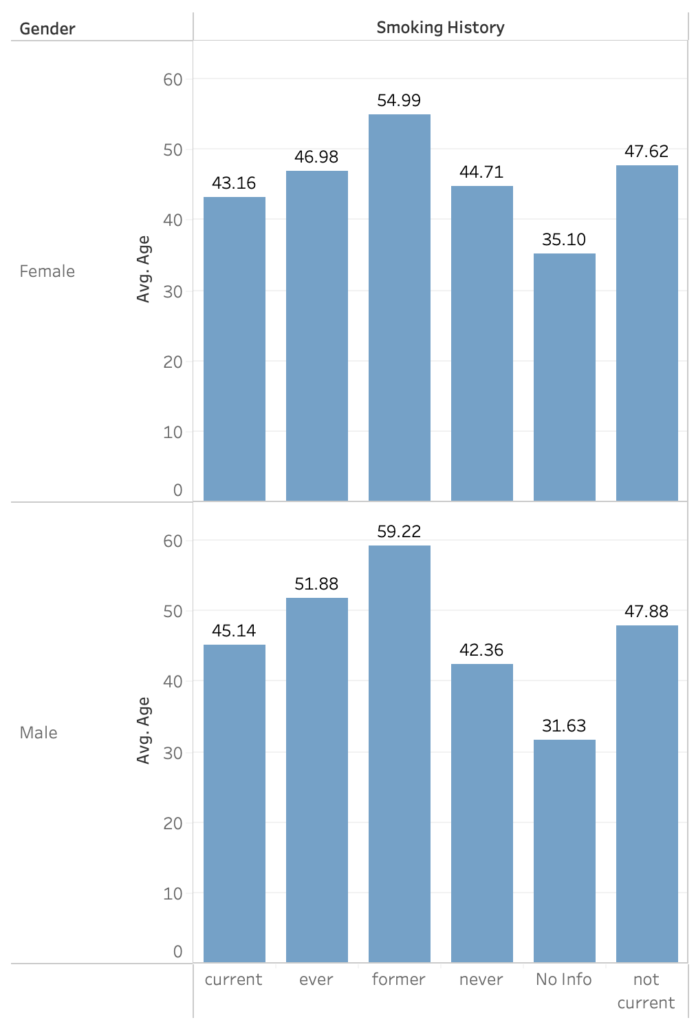
Age and Gender vs. Smoking Status
This chart shows the average age of our dataset broken down further by gender and smoking history.
The average age across the smoking statuses are substantially equal.

Slide 6
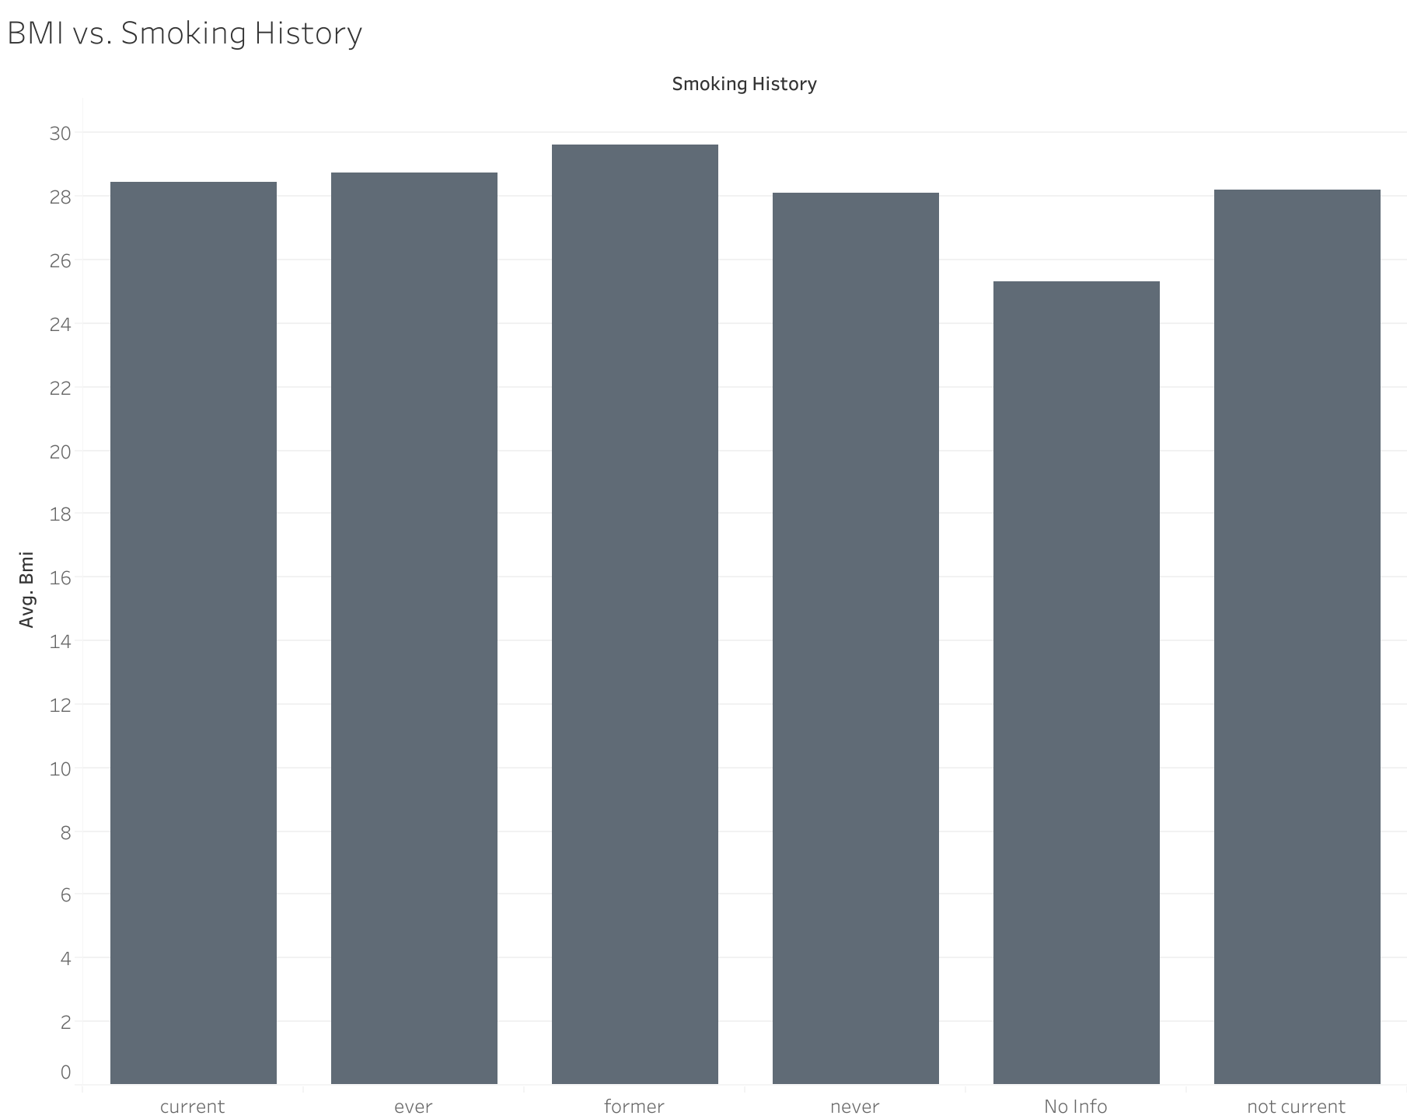
BMI vs. Smoking History
Per the Center for Disease Control and Prevention::
Underweight = <18.5
Healthy Weight b/t 18.5 to 24.9
Overweight b/t 25.0 to 29.9
Obese = >30.0
BMI was our #4 contributing factor of diabetes. From this figure, we can see that the average across the smoking statuses are in the overweight range.

Slide 7
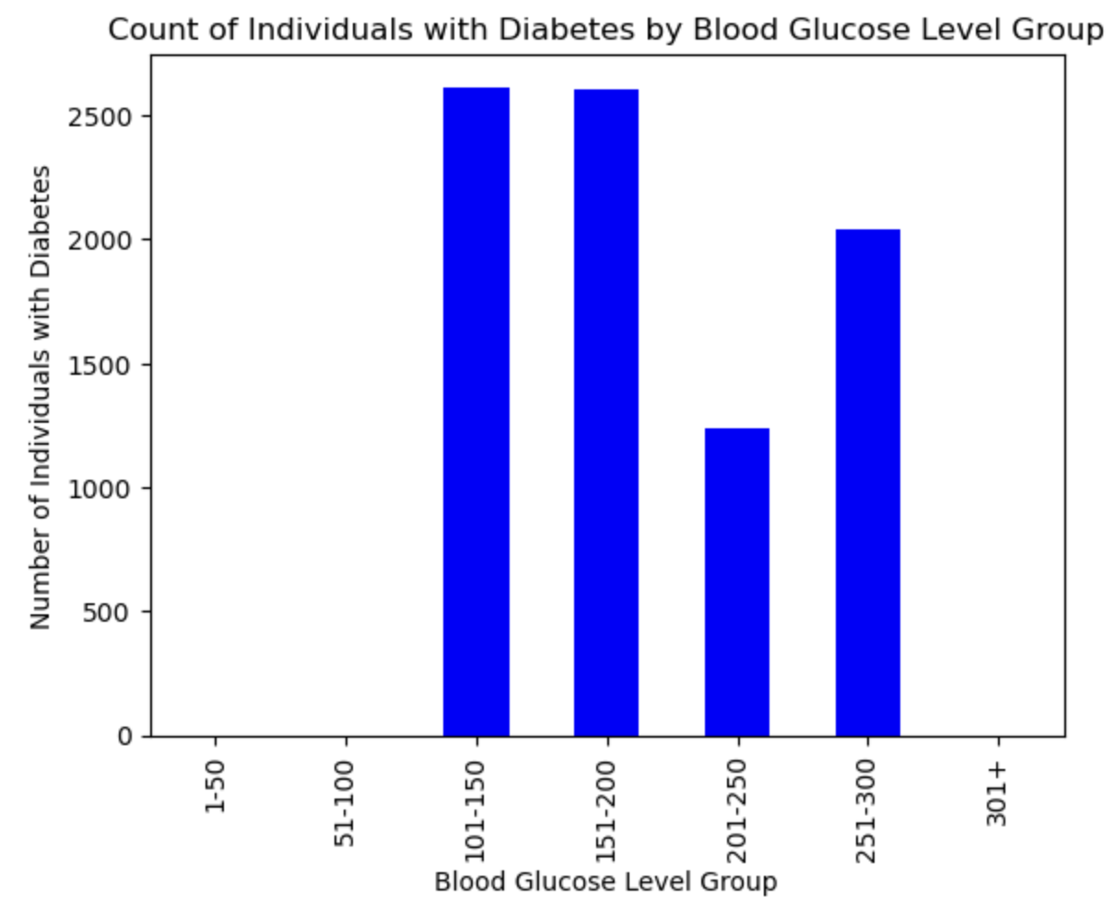
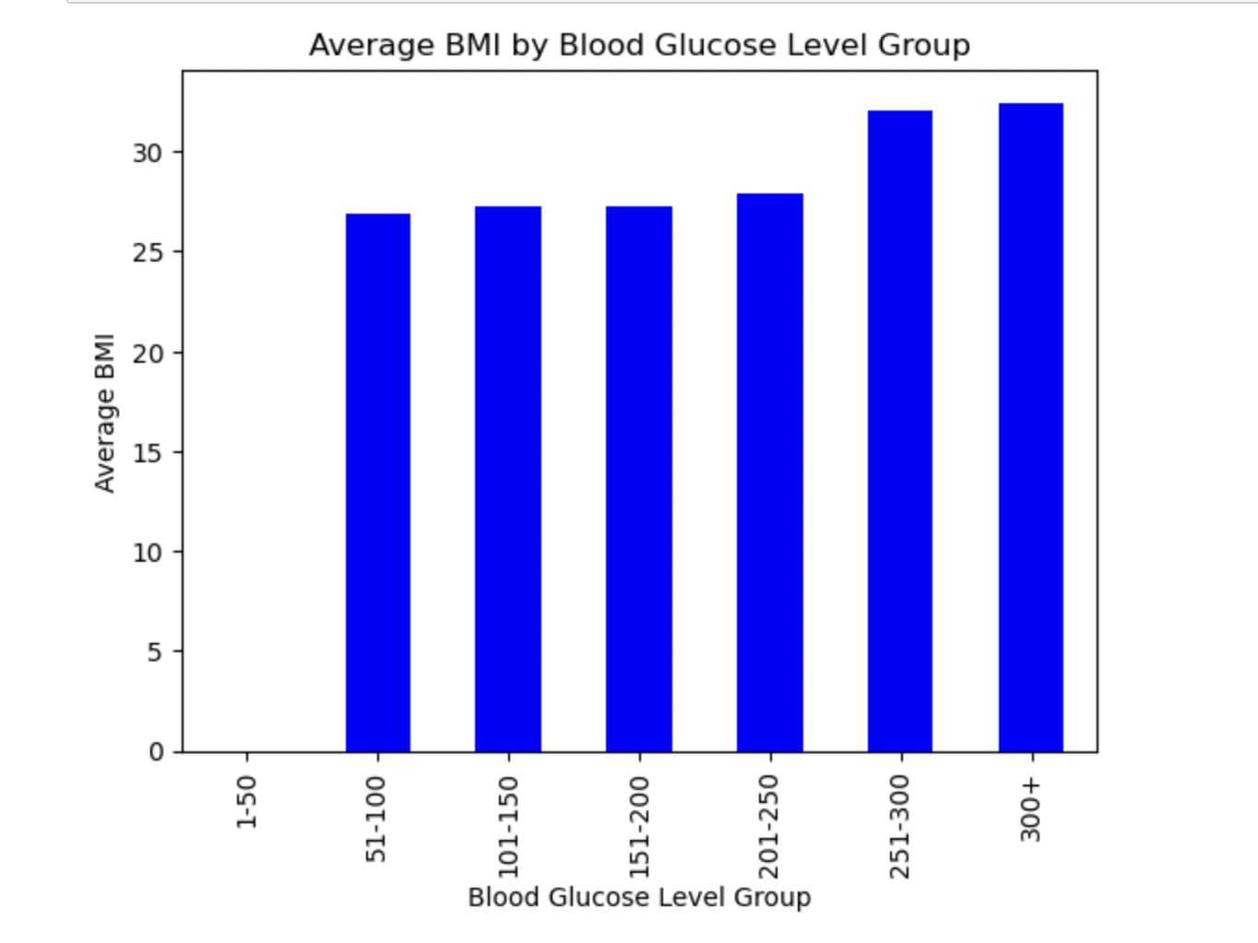
Diabetes and Blood Glucose Levels
Average blood glucose level is under 125
There is a relationship where high BMI can lead to increased insulin resistance, which in turn can lead to higher blood glucose levels which then can contribute to the development of diabetes.

Slide 8
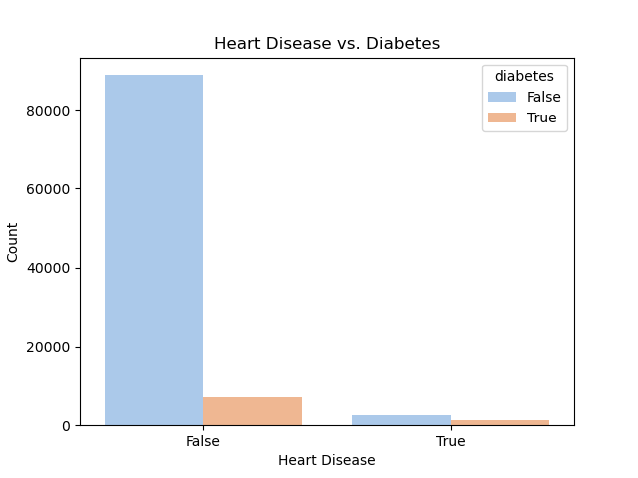
Heart Disease vs. Diabetes
Over time, high blood sugar can damage blood vessels and the nerves that control your heart, leading to heart disease.
1,267 people in our dataset had both heart disease and diabetes.

Slide 9
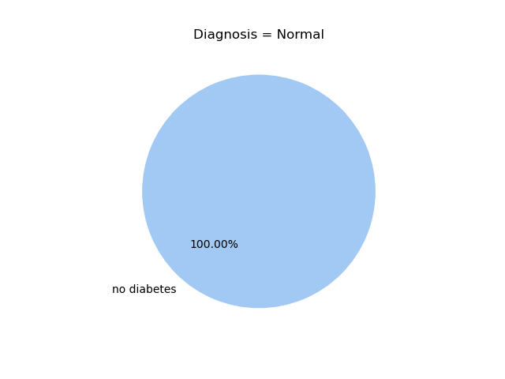
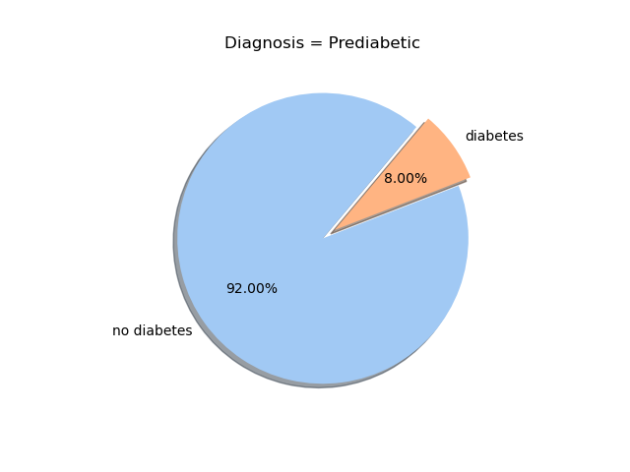
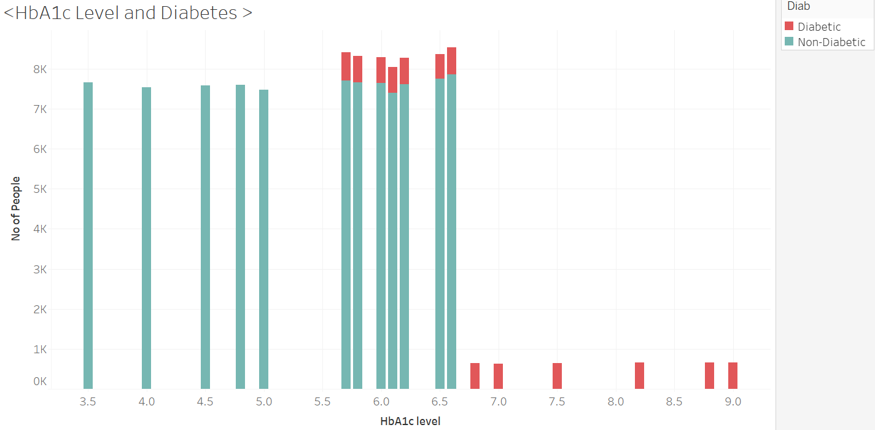
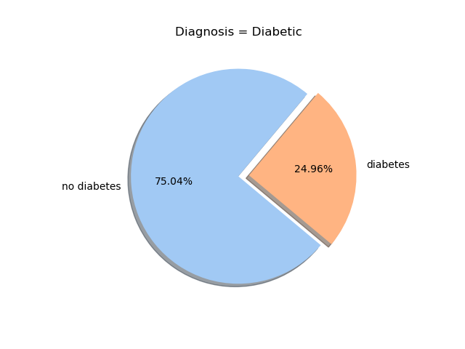
HbA1c Level and Diabetes
HbA1c (Hemoglobin A1c) level is a measure of a person's average blood sugar level over the past 2-3 months. 5.7% to 6.4% indicates prediabetes, and a level of 6.5% or more indicates diabetes.

Slide 10
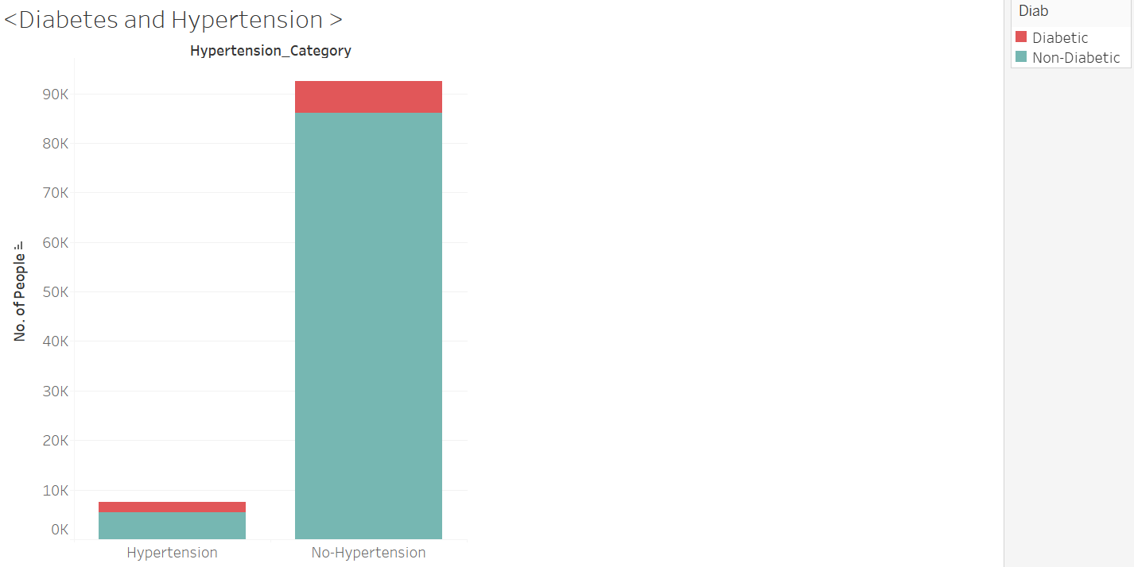
Diabetes and Hypertension
Hypertension is a medical condition in which the blood pressure in the arteries is persistently elevated. 27% of people with hypertension have diabetes while 6.9% of people with no hypertension have diabetics. This indicates hypertension increases the chance of being diabetic.

Slide 11
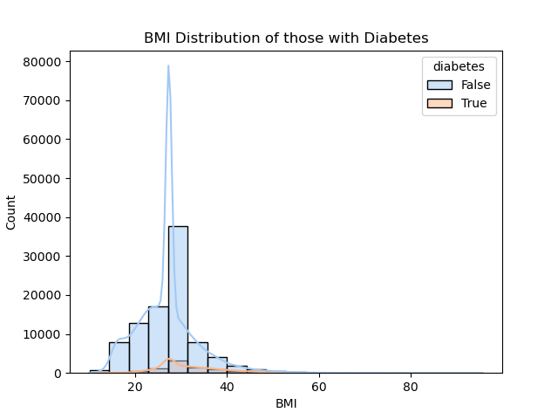
BMI vs. Diabetes
Analyzing the BMI distribution of those with diabetes.
Diabetes is more prevalent in those with a higher BMI.

Slide 12
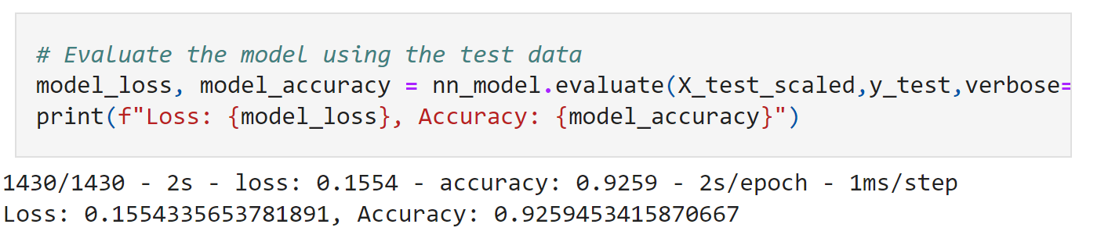
Sequential Model

Slide 13
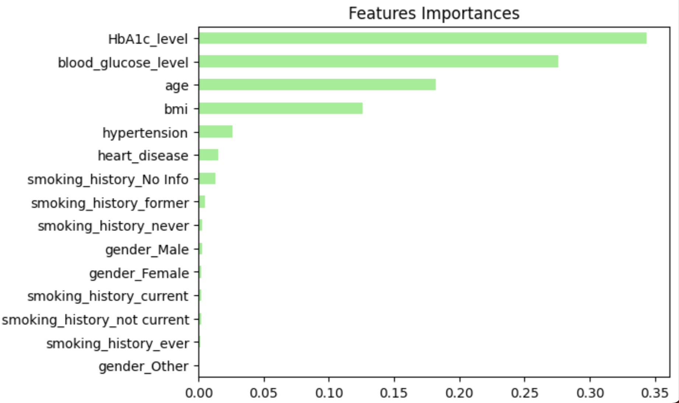
Random Forest

Slide 14
Confusion Matrix
Predicted 0 Predicted 1
Actual 0 22420 490
Actual 1 0 22840
Predicted Yes When Yes Diabetes 22420
Predicted Yes When No Diabetes 0
Predicted No Diabetes When No 22840
Predicted Yes When No 490

Slide 15
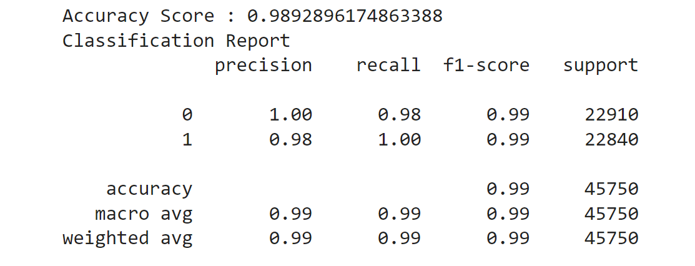
Random Forest Model

Slide 16
Results and Conclusions
Our Sequential Model had a 92% accuracy and our Random Forest Model had a 99% accuracy when predicting diabetes.
The Random Forest Model was the best predictor for this dataset due it’s almost 100% accuracy.
Another model that could be tested for this dataset is the survivor model which predicts the chance of surviving diabetes.
HbA1c, blood glucose level and age have the highest impact on Diabetes.

Slide 17
Resources
https://www.kaggle.com/datasets/iammustafatz/diabetes-prediction-dataset/data
Mean fasting blood glucose - World Health Organization (WHO)World Health Organizationhttps://www.who.int › ... › Indicator Metadata Registry List
https://www.ncbi.nlm.nih.gov/books/NBK549816/#:~:text=For%20an%20HbA1c%20test%20to,HbA1c%20of%206.5%25%20or%20higher.
https://www.cdc.gov/cdi/definitions/older-adults.html
https://www.cdc.gov/healthyweight/assessing/bmi/adult_bmi/index.html
https://www.cdc.gov/diabetes/library/features/diabetes-and-heart.html#:~:text=Over%20time%2C%20high%20blood%20sugar,and%20can%20damage%20artery%20walls.

